Slide 1

Module 3: Individual Peacekeeping Personnel
Lesson
3.1
UN Core Values and Competencies

Slide 2

Relevance
Rich cultural and institutional diversity between military, police, civilian
Organizational Core Values and Competencies create a shared language
UN Core Pre-Deployment Training Materials 2017

Slide 3
Learning Outcomes
Learners will:
List UN Core Values and Competencies
Explain their importance
Describe different ways peacekeeping personnel build on UN Core Competencies
UN Core Pre-Deployment Training Materials 2017

Slide 4
Lesson Overview
Definitions
Importance
UN Core Values
UN Core Competencies
Managerial Competencies
Continuous Learning
What Individual Peacekeeping Personnel Can Do
UN Core Pre-Deployment Training Materials 2017

Slide 5
Learning Activity
3.1.1
Values and Competencies
Instructions:
What does it mean to have “principles”?
How do “principles” and high quality work contribute to a positive image?
What skills and behaviours lead to success in work?
Time: 5 minutes
Brainstorming: 3 minutes
Discussion: 2 minutes
UN Core Pre-Deployment Training Materials 2017
Notes:
Instructor: performance, high quality work, highly skilled personnel
Q:Give examples of “principles”

Slide 6
1. Definitions
Organizational Core Values: shared principles and beliefs underpinning work of organization, and guiding actions and behaviours of staff
Organizational Core Competencies: skills, attributes and behaviours important for all staff
Managerial Competencies: skills, attributes and behaviours considered essential for staff with managerial/supervisory responsibilities
UN Core Pre-Deployment Training Materials 2017

Slide 7
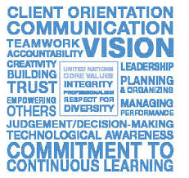
2. Why are UN Core Values and Competencies Important?
Guides you as an ambassador of the UN
Capitalizes on the key to UN success – quality of its personnel and managers
Creates organizational culture and environment for personnel to contribute maximum potential
Builds human resources capacity for the future
UN Core Pre-Deployment Training Materials 2017

Slide 8
Learning Activity
3.1.2
What UN Core Values and Competencies Mean
Instructions:
Match images with UN values and competencies
Discuss the meaning of each
How do they guide you as a UN ambassador?
How do they contribute to success of the mission?
Time: 10 minutes
Group work: 5-7 minutes
Discussion: 3 minutes
UN Core Pre-Deployment Training Materials 2017
Notes:
CPTM 3.1.3
Instructor: Link with credibility, legitimacy – trust, duty – clients, mandate beneficiaries – being an ambassador – conduct – reputation and image

Slide 9

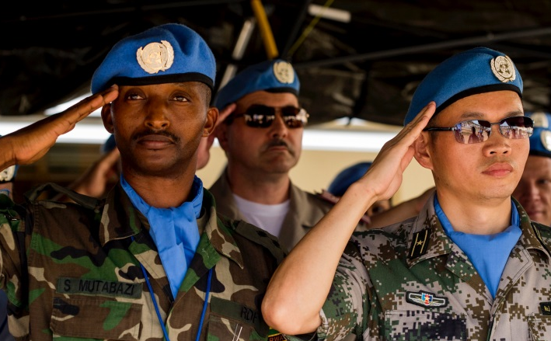

3. UN Core Values
Integrity
Professionalism
Respect for Diversity
UN Core Pre-Deployment Training Materials 2017

Slide 10
Integrity
Demonstrate the values of UN
Act without consideration of personal gain
Resist undue political pressure
Stand by decisions in the organization’s interest
Do not abuse power or authority
Take prompt action in cases of unprofessional or unethical behaviour
UN Core Pre-Deployment Training Materials 2017

Slide 11
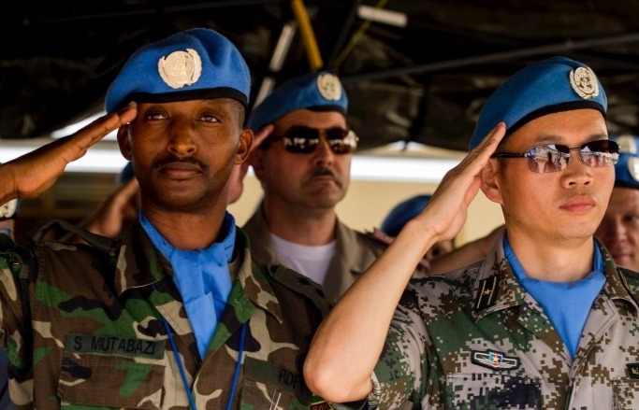
Professionalism
Show pride in work and achievements
Demonstrate professional competence
Be conscientious and efficient in meeting commitments
Be motivated by professional rather than personal concerns
Show persistence when faced with challenges
Remain calm in stressful situations
UN Core Pre-Deployment Training Materials 2017

Slide 12
Respect for Diversity
Work effectively with people from all backgrounds
Treat all people with dignity and respect
Treat men and women equally
Show respect for diverse points of view
Examine own biases and behaviours
Do not discriminate against any individual or group
UN Core Pre-Deployment Training Materials 2017

Slide 13








4. UN Core Competencies
Communication
Teamwork
Planning and Organization
Accountability
Client Orientation
Creativity
Technological Awareness
Commitment to Continuous Learning
UN Core Pre-Deployment Training Materials 2017

Slide 14

Communication
Speak and write clearly
Listen to others and respond appropriately
Two-way communication
Tailor language, tone, style
Share information
UN Core Pre-Deployment Training Materials 2017

Slide 15
Teamwork
Work collaboratively with colleagues
Solicit input by genuinely valuing others’ ideas
Place team agenda before personal agenda
Support group decisions
Share credit, joint responsibility for shortcomings
UN Core Pre-Deployment Training Materials 2017

Slide 16

Planning and Organizing
Develop clear goals that are consistent with agreed strategies
Identify priority activities and adjust as required
Allocate appropriate time and resources for completing work
Foresee risk and allow for contingencies
Monitor and adjust plans as
necessary
Use time efficiently
UN Core Pre-Deployment Training Materials 2017

Slide 17
Accountability
Take ownership of responsibilities and honour commitments
Deliver outputs within prescribed time, cost and quality
Operate in compliance with rules
Support subordinates, provide oversight and take responsibility for delegated assignments
Take responsibility for
shortcomings
UN Core Pre-Deployment Training Materials 2017

Slide 18
Client Orientation
Consider all “clients” and seek their point of view
Establish and maintain productive partnerships
Identify clients’ needs and provide solutions
Monitor the clients’ environment and anticipate problems
Keep clients informed of progress or setbacks in projects
Meet timelines for delivery of
products or services to clients
UN Core Pre-Deployment Training Materials 2017

Slide 19

Creativity
Actively seek to improve services
Offer new and different options to meet client needs
Promote and persuade others to consider new ideas
Take calculated risks – think “outside the box”
Take an interest in new ideas
Do not be bound by traditional approaches
UN Core Pre-Deployment Training Materials 2017

Slide 20

Technological Awareness
Keep abreast of available technology
Understand applicability and limitations of technology
Actively seek to apply technology to appropriate risks
Show willingness to learn new technology
UN Core Pre-Deployment Training Materials 2017

Slide 21
Commitment to Continuous Learning
Keep abreast of new developments
Actively seek to develop oneself professionally and personally
Contribute to the learning of colleagues and subordinates
Show willingness to learn from others
Seek feedback to learn and improve
UN Core Pre-Deployment Training Materials 2017
Notes:
Reference the Learning Policy SGB 2009?

Slide 22

5. Managerial Competencies
Leadership
Vision
Empowering Others
Building Trust
Managing Performance
Judgment/Decision-Making
UN Core Pre-Deployment Training Materials 2017

Slide 23
Learning Activity
3.1.3
Continuous Learning
Instructions:
Consider the UN Core Values and Competencies
What is your responsibility?
Describe ways you can gain the knowledge, skills and attributes needed to do your job well
Time: 5 minutes
Brainstorming: 3 minutes
Discussion: 2 minutes
UN Core Pre-Deployment Training Materials 2017

Slide 24
6. Continuous Learning
DPKO-DFS Integrated Training Service
Deployment
Pre-Deployment Training
Induction
On-Going
Training Phases
Member States
United Nations
Responsibility
In Country
In Mission
Location
UN Core Pre-Deployment Training Materials 2017

Slide 25
DPKO-DFS Best Practices & Training
Integrated Mission Training Centres (IMTCs) | Induction Training Ongoing Training
Knowledge Sharing Tools | After Action Reviews Lessons Learned Surveys of Practice End of Assignment Reports
Other Resources | Best Practice Officers Communities of Practice Peacekeeping Resource Hub (http://research.un.org/en/peacekeeping-community) Policy & Practice Database – UN access only (http://ppdb.un.org) Inspira (http://inspira.un.org)
UN Core Pre-Deployment Training Materials 2017
Notes:
New cycle diagram???

Slide 26



UN Learning & Staff Development
https://hr.un.org
http://unitar.org
http://unssc.org
UN Core Pre-Deployment Training Materials 2017

Slide 27
7. What Individual Peacekeeping Personnel Can Do
Be an ambassador of the UN
Uphold, demonstrate and strengthen UN Core Values and Competencies
Build on UN Core Competencies through:
Training and learning activities
Coaching and mentoring
Feedback/appraisals
Lessons learned from experience
UN Core Pre-Deployment Training Materials 2017

Slide 28
Summary of Key Messages
Uphold UN Core Values – integrity, professionalism, respect for diversity
UN Core Values and Competencies guide you as an ambassador of the UN
Build UN Core Competencies – training, learning, coaching, mentoring, feedback, appraisals, lessons learned
UN Core Pre-Deployment Training Materials 2017

Slide 29
Questions
UN Core Pre-Deployment Training Materials 2017

Slide 30
Learning Activity
Learning Evaluation
UN Core Pre-Deployment Training Materials 2017

